Slide 1
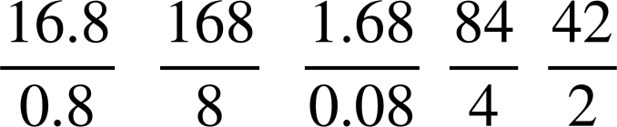
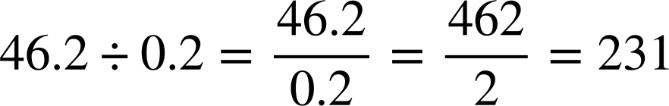
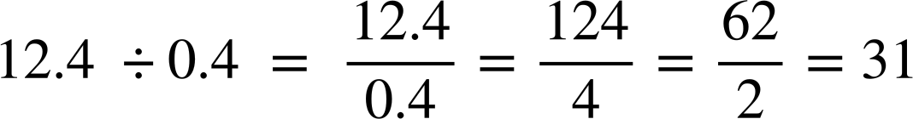
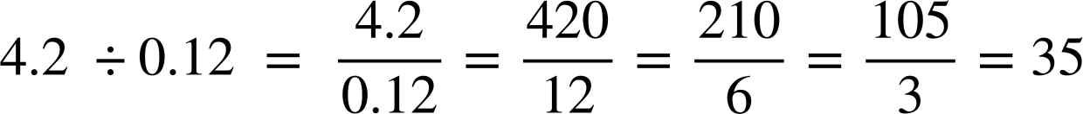

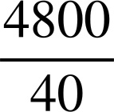


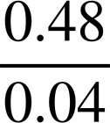
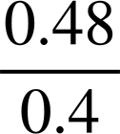

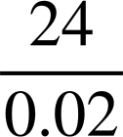

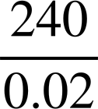

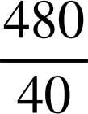

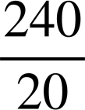
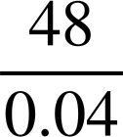


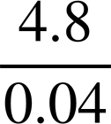
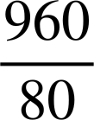

Dividing with decimals
Task A: Divisions written as fractions
Fill in the blanks so the fraction is equivalent to the calculation.
16.8 ÷ 0.8
2) Work out the answer to the following. You must show your working out.
a)
b)
c)
3) Shade in all the equivalent fractions to
4.8 ÷ 0.4
to reveal a word.
The word is ‘Hi’

Slide 2
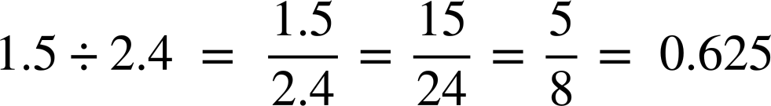
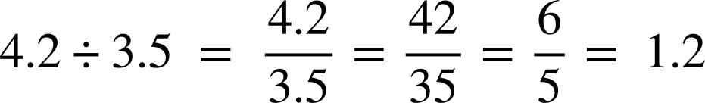
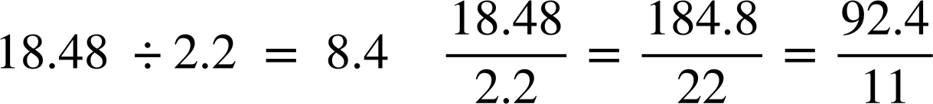
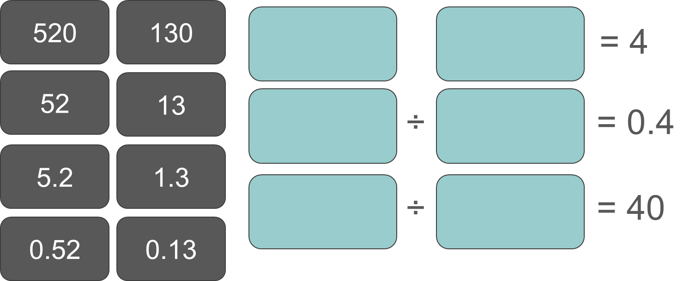

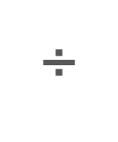







Dividing with decimals
Task B: Dividing using decimals
1) Show your working out for the following calculations.
a)
b)
c)
0
2
5
6
.
8
5
5
2
4
.
0
0
0
1
2
.
5
6
1
.
0
8
4
.
4
11
92 4
.
2) Use the numbers on the cards to complete the divisions. You may use each card only once.
Can you find more than one way this can be done?
Mathematics in Education and Industry
v2.2

